Slide 1
Book-King
Professional Practice in IT 3rd Year Project
Arron Healy G00346883
Mark Gilmore G00214777

Slide 2
Introduction
Book-King is a website that allows users to buy and sell books as well as create and comment on threads about books
It is created using the MERN stack (MongoDB, Express, React, NodeJS) and Redux

Slide 3
The idea
After our first meeting we decided that we would build a market place that allowed users to buy and sell their books online. This idea of course is very common online so we decided to not only make a market place but make it a social media like hub for like minded book enthusiasts.
After careful consideration we decided to build it using the MERN stack and Redux.

Slide 4
Aims and objectives
To build a social media like website that allowed like minded people buy, sell and converse about books
Learn new technologies no included in the course (React, Redux)
Gain a better understanding of version control
Learn to work as a team on big projects

Slide 5
Architecture
We used the MERN stack to build the project.
MERN stack is a free, open source JavaScript software stack for building dynamic websites and web applications
The MERN stack is made up of the following components:
MongoDB
Express
React
NodeJS

Slide 6
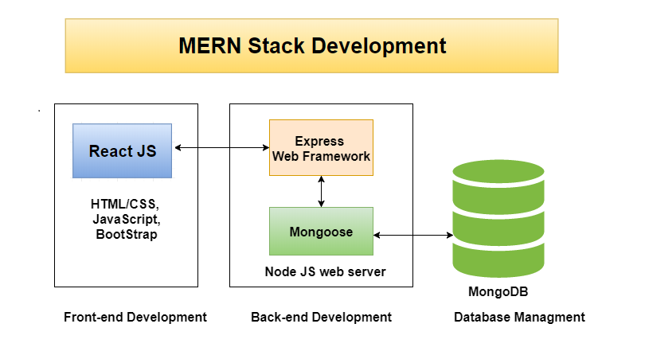

Slide 7
Why mern stack
In our 1st semester of 3rd year we used the MEAN stack and wanted to learn something new that was not part of our course.
After considering similar libraries to the MEAN stack (MERN, VUE) we decided to use the MERN stack
Maintained by Facebook and seemed the more popular of the two

Slide 8
Redux
An open-source JavaScript library for managing an applications state

Slide 9
Libraries used
Axios
Classnames
Formdata
Jwt-decode
Multer
React-Redux
Bcryptjs
Body-parser
Concurrently
Passport
Validator

Slide 10
Timetable
Weeks 1-2: Get to grips with React and Redux by doing several YouTube tutorials and initial project skeleton setup
Weeks 3-4: Login and Register. Arron (Backend), Mark (Frontend)
Weeks 4-5: Profile (Add, Delete etc.), Dashboard, Book (List, Add, Delete etc.)
Weeks 6-7: Arron (Post, Post feed etc.), Mark (Shopping Cart)
Weeks 8-9: Book and Profile Image, Search Bar
Weeks 10: README, Tidy Code, Heroku Setup

Slide 11
Problems encountered
Learning new technologies in a short space of time
Learning to work together on a team project for the first time

Slide 12
Conclusions
Overall building the project was a very enjoyable experience. As well as learning new technologies we developed our communication skills, our ability to work as a team, a better understanding of version control and most importantly we gained valuable knowledge of what it is expected in the industry. We overcame any obstacles by working together and learned that it is better to have two people working together than trying to do things on our own.

